Slide 1

Industrial Cardan Shafts Manufacturer
+91 931-1129-661/62
Reliable and Quality Solutions
For more information: https://www.nuhydro.com/

Slide 2
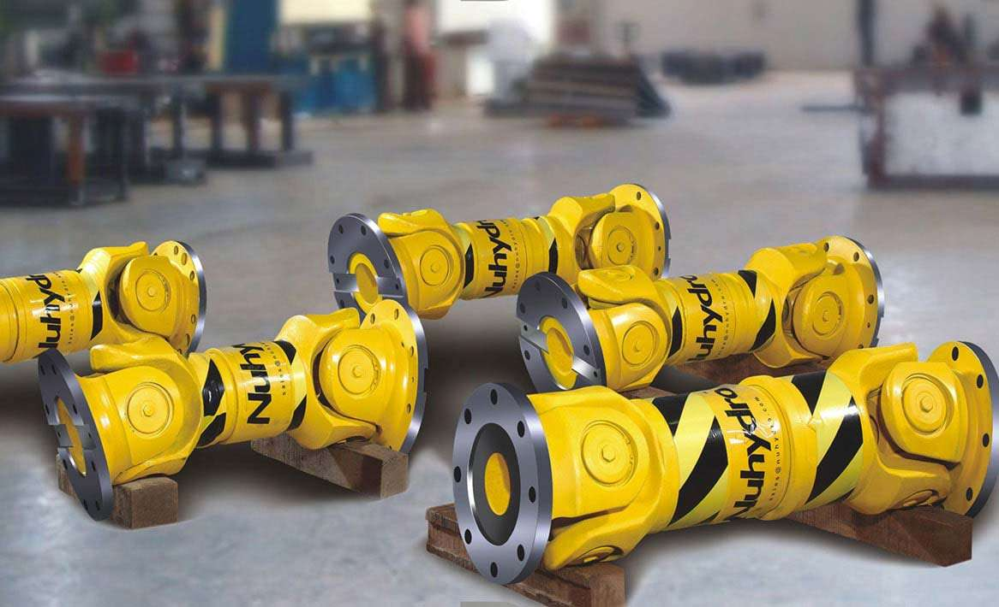
+91 931-1129-661/62
For more information: https://www.nuhydro.com/

Slide 3
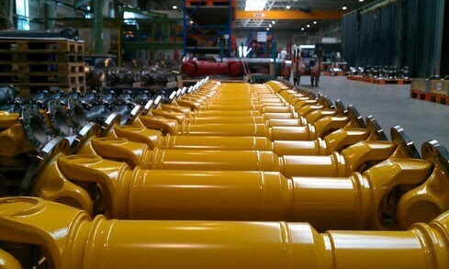
+91 931-1129-661/62
For more information: https://www.nuhydro.com/

Slide 4
+91 931-1129-661/62
Contact Us
Nuhydro Automation
B-26, Sector 67, Uttar Pradesh, India
Noida-201307
Ph: 91 9311129661
Mail: sales@nuhydro.com
For more information: https://www.nuhydro.com/

