Slide 1
Blood Sample Collection from Home in Delhi
Home Blood Sample Collection
https://www.trutestlab.com/blood-sample-collection-at-home

Slide 2
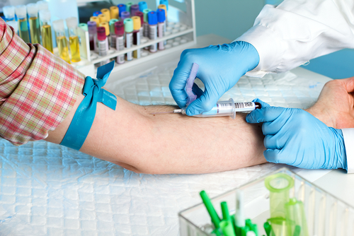
https://www.trutestlab.com/blood-sample-collection-at-home

Slide 3
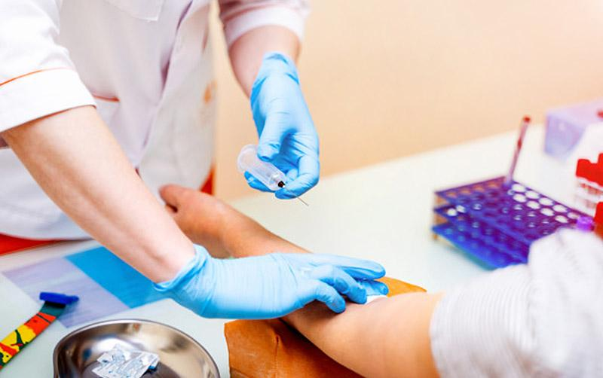
https://www.trutestlab.com/blood-sample-collection-at-home

Slide 4
Contact us
TRUTEST Laboratories (Powered By iGenetic Diagnostics)
Gurudwara Singh Sabha, L-30 C, Basement , Malviya Nagar, Near, New Delhi, Delhi
Pin: 110017
Phone: 1800 210 1616
https://www.trutestlab.com/blood-sample-collection-at-home

