Slide 1
DLF One Midtown
DLF One Midtown is one of the most awaited luxury residential projects located at Shivaji Marg, Moti Nagar, Delhi.
https://www.nofrillsdeal.com/dlf-one-midtown-delhi

Slide 2
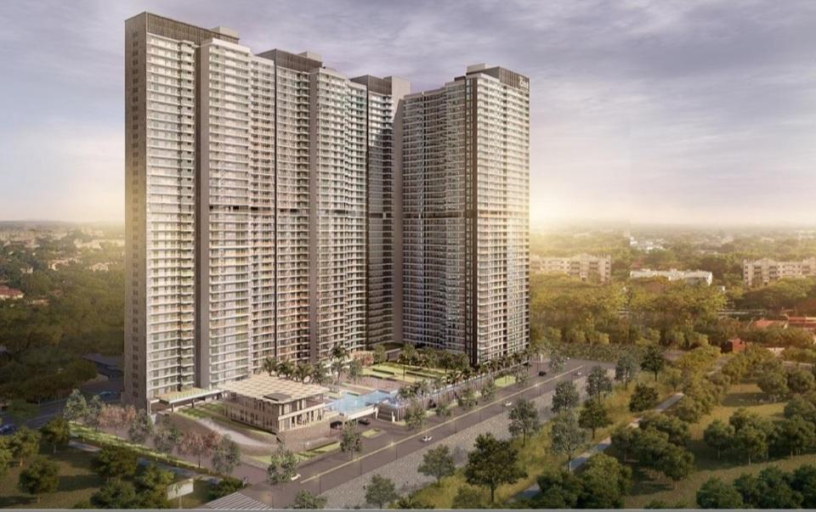
https://www.nofrillsdeal.com/dlf-one-midtown-delhi

Slide 3
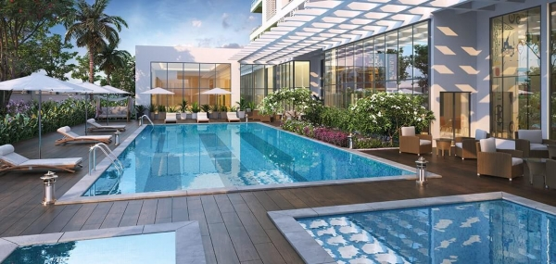
https://www.nofrillsdeal.com/dlf-one-midtown-delhi

Slide 4
Contact Us
Phone No: 9999999237
Email ID: info@nofrillsdeal.com
Address: 9/52, Kirti Nagar Industrial Area, Delhi 110015, INDIA
https://www.nofrillsdeal.com/dlf-one-midtown-delhi

