Slide 1
Omaxe Project in Karol Bagh Delhi
9999999237, 9999999238
Turning Dream Into Reality
For more information: https://www.omaxe-karolbagh.com/

Slide 2
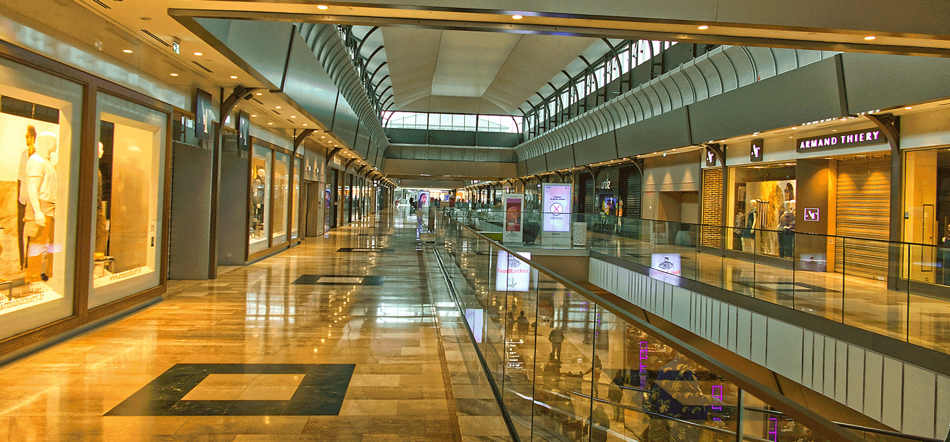
9999999237, 9999999238
For more information: https://www.omaxe-karolbagh.com/

Slide 3
Contact Us
Address: Omaxe Karol Bagh, New Delhi, 110005
Contact No. - 9999999237, 9999999238
Email - info@nofrillsdeal.com
Website: https://www.omaxe-karolbagh.com/

