Slide 1
Best Resorts in Havelock Island
A Dream Stay At The Best Price
For more information: https://www.havelockislandbeachresort.com/

Slide 2
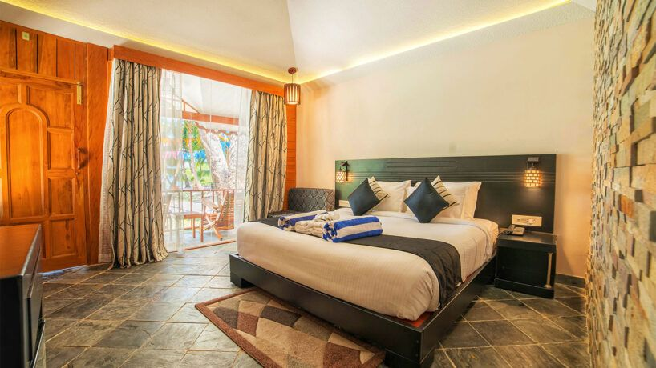
Havelock island hotels and resorts are well-known for the generous amenities they provide to their guests. The island is a popular destination for both honeymooners and solo travellers. Because of this, Havelock Island is home to some of the best hotels in Andaman and Nicobar.
For more information: https://www.havelockislandbeachresort.com/

Slide 3
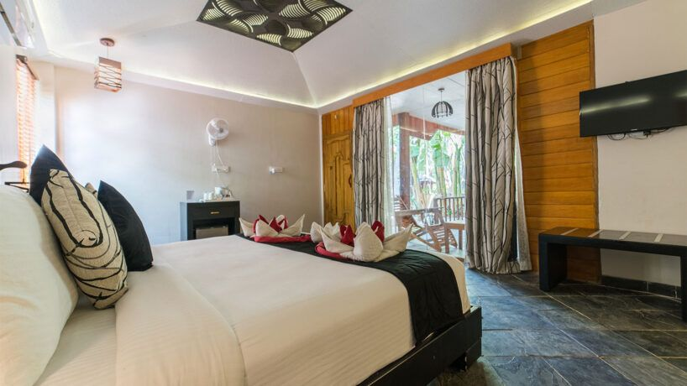
For more information: https://www.havelockislandbeachresort.com/

Slide 4
Contact Us
Contact Details:
Havelock Islands Beach Resort
Govind Nagar Beach,Swaraj Dweep (Havelock Island)
Andaman & Nicobar Island - 744211
Mob: +91 9599920849 /+91 8130509887 /+91 7428996082
Email: contact@havelockislandbeachresort.com
Web: https://www.havelockislandbeachresort.com/

