Slide 1
Best and Affordable Acne Scar Treatment In Delhi
Spots & Acne Scar Treatment Delhi
Website: https://www.cosmeticdermatologyindia.com/solutions/laser-acne-scar-treatment-delhi

Slide 2
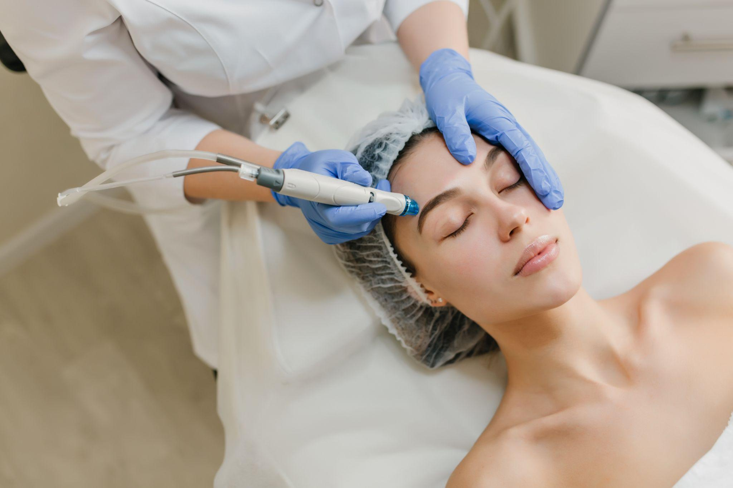
Website: https://www.cosmeticdermatologyindia.com/solutions/laser-acne-scar-treatment-delhi

Slide 3
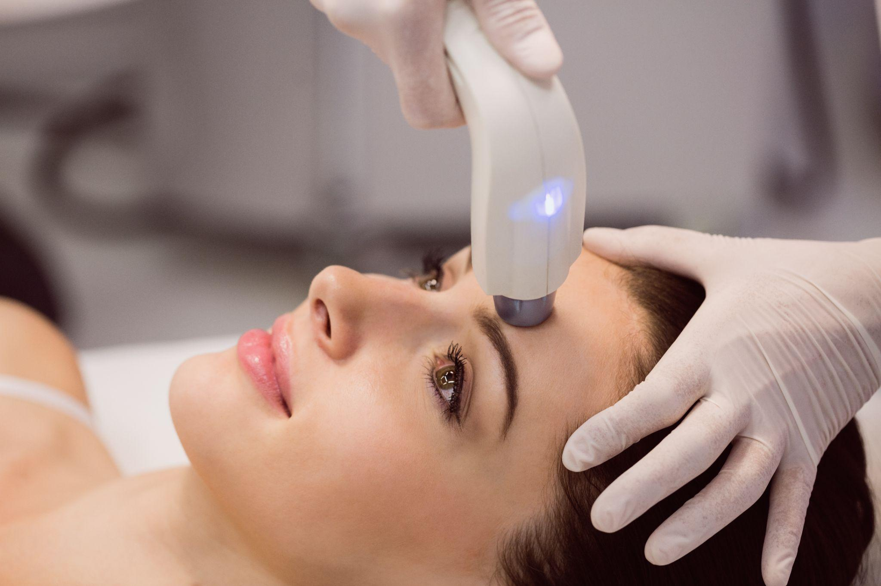
Website: https://www.cosmeticdermatologyindia.com/solutions/laser-acne-scar-treatment-delhi

Slide 4
Contact Us
Delhi AAYNA Clinic (Mehrauli)
Address: Ambawatta One, H5/5, First Floor, Kalka Das Marg, Mehrauli, New Delhi 110030, India.
Phone: +91-7042297304,+91-9650205873,+91-9650206153
Mail: query@cosmeticdermatologyindia.com
Website: https://www.cosmeticdermatologyindia.com/solutions/laser-acne-scar-treatment-delhi

