Slide 1
Book Blood Sample Collection from Home in Delhi
Phone: 1800 210 1616 Mail: support@igenetic.com
TRUTEST Laboratories is one of the fastest growing chain of pathology laboratories in the country.
Visit Website: https://www.trutestlab.com/blood-sample-collection-at-home

Slide 2
Phone: 1800 210 1616 Mail: support@igenetic.com
Advantage of
Home Blood Sample Collection
Blood sample testing is an important part of a routine check-up. With a fast-paced and hectic lifestyle, it is easy to overlook these vital check-ups. TRUTEST Laboratories provides home blood and urine collection by highly trained and experienced phlebotomists.
Visit Website: https://www.trutestlab.com/blood-sample-collection-at-home

Slide 3
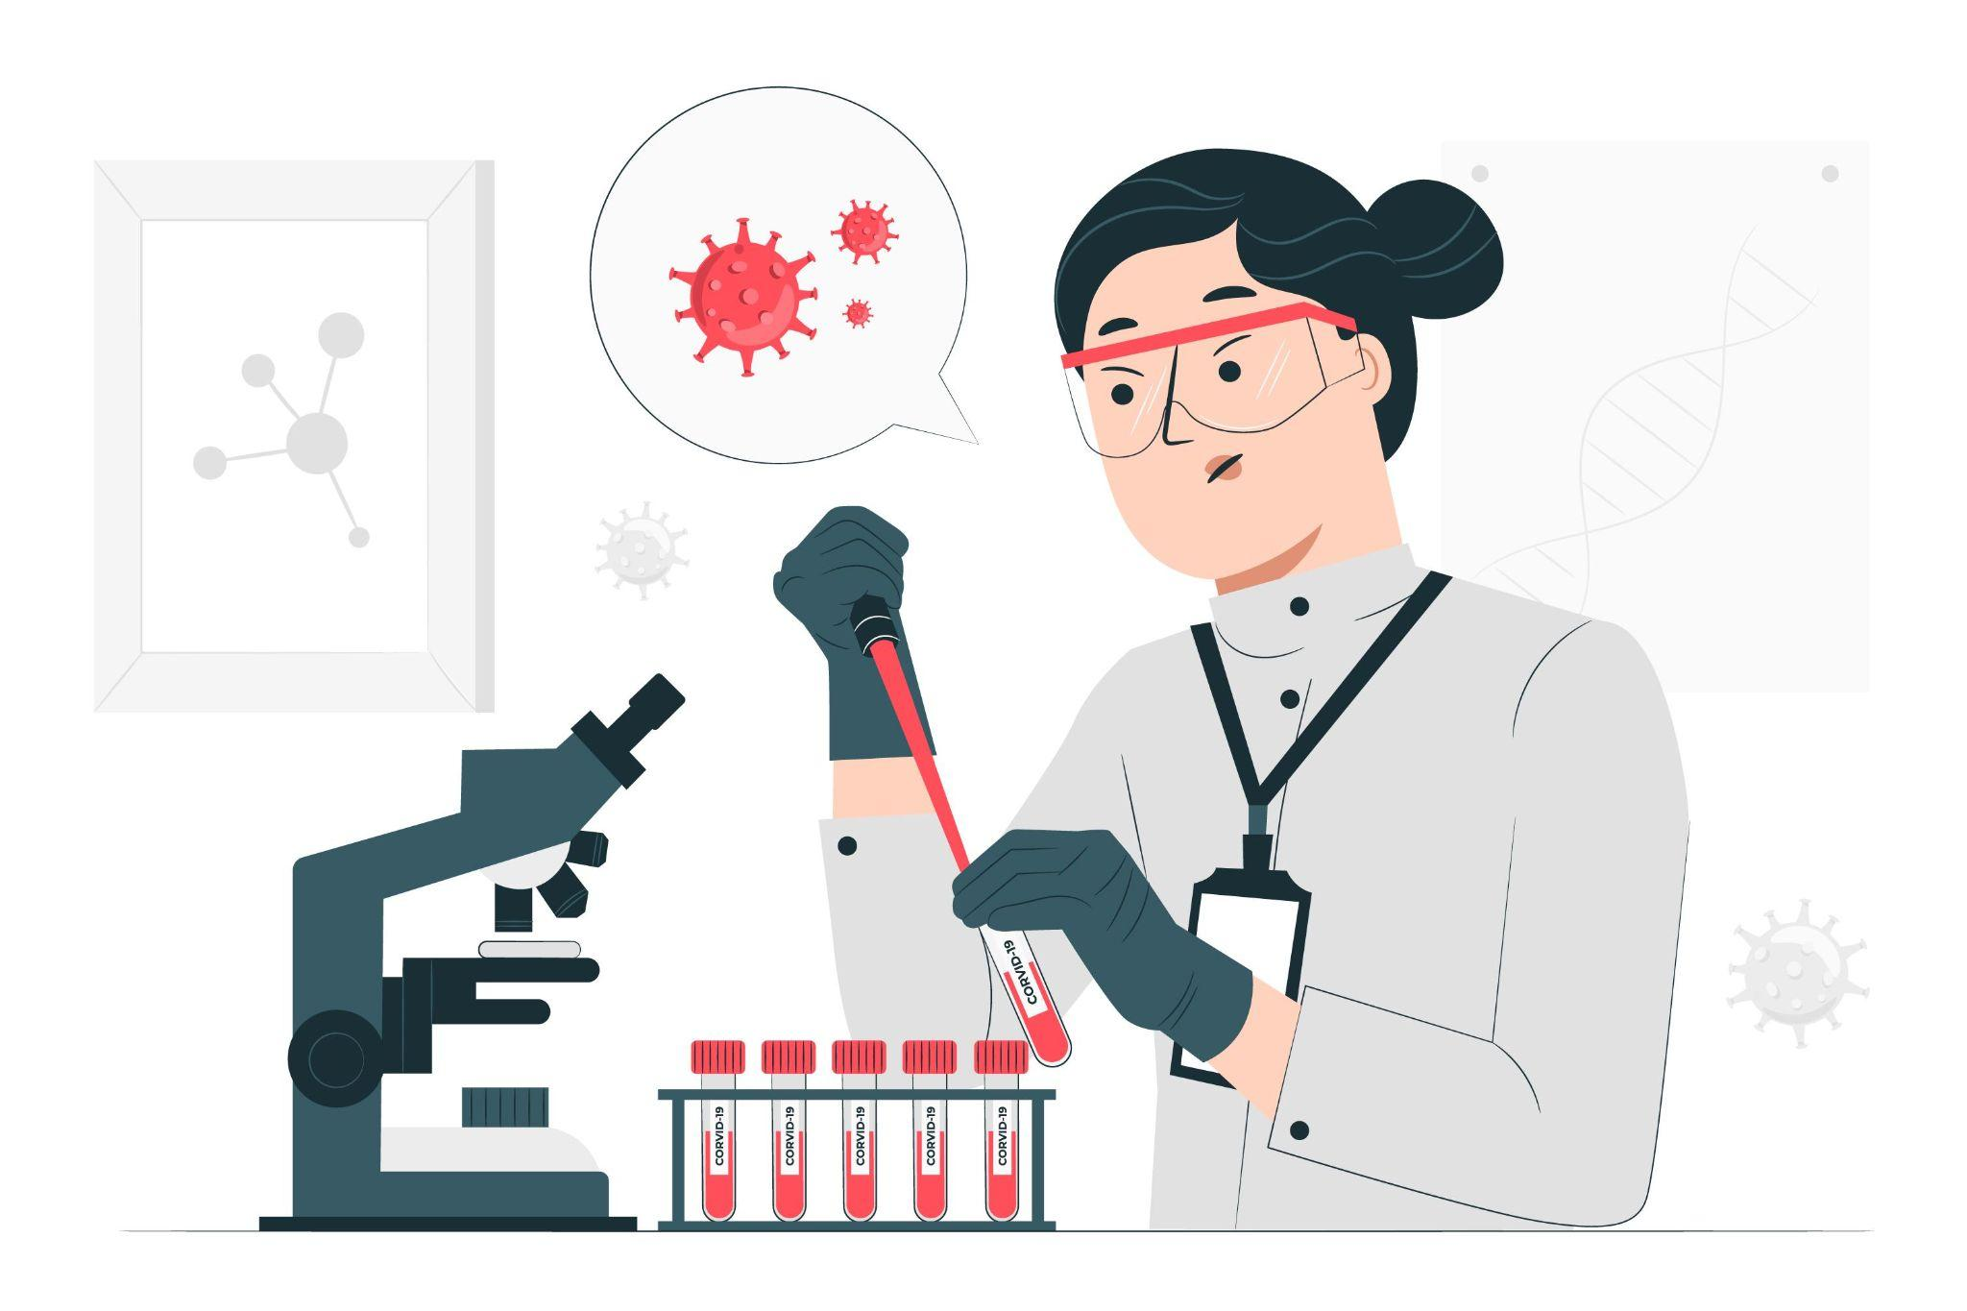
Phone: 1800 210 1616 Mail: support@igenetic.com
Visit Website: https://www.trutestlab.com/blood-sample-collection-at-home

Slide 4
Contact Us
TRUTEST Laboratories is one of the fastest growing chain of pathology laboratories in the country.
Web: https://www.trutestlab.com/
Phone: 18002101616
Mail: support@igenetic.com

