Slide 1
Buy Sitar Online
Rikhi Ram Musical Instrument Mfg. Co. (Rikhi Ram Originals) is India's oldest INDIAN CLASSICAL INSTRUMENTS manufacturing company. Indian classical music has grown rapidly in popularity around the world over the years.
For more information: https://www.shop.rikhiram.com/

Slide 2
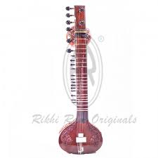
For more information: https://www.shop.rikhiram.com/

Slide 3
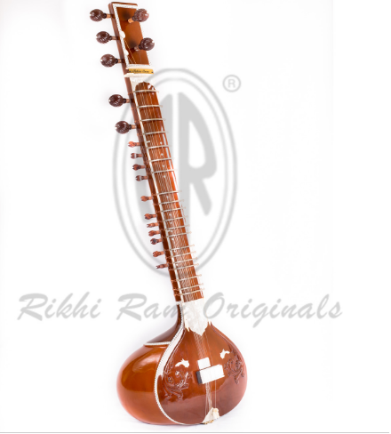
For more information: https://www.shop.rikhiram.com/

Slide 4
Contact Us
Address: G-8 Marina Arcade, Connaught Circus, New Delhi, Delhi 110001
Phone: 01141516141, 01123327685
Mail: info@rikhiram.com
Web: https://www.shop.rikhiram.com/category/bowing-instruments

