Slide 1
Food Court in Devika Sadar Bazar Food Court
Phone: 08888672888
Devika Sadar Bazar, a new commercial development by well-known player Devika Group, features spacious lockable retail units.
Website: https://www.devika-sadarbazar.com/

Slide 2
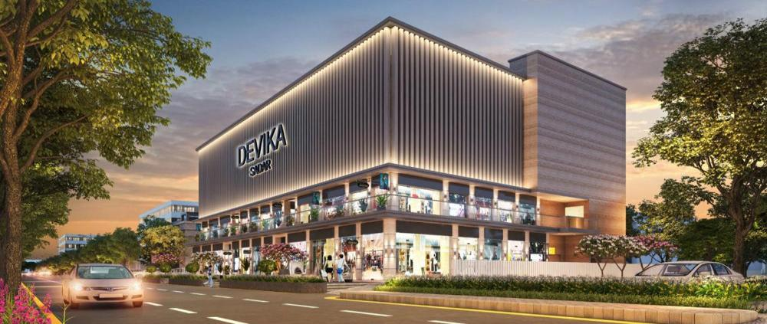
Phone: 08888672888
Website: https://www.devika-sadarbazar.com/

Slide 3
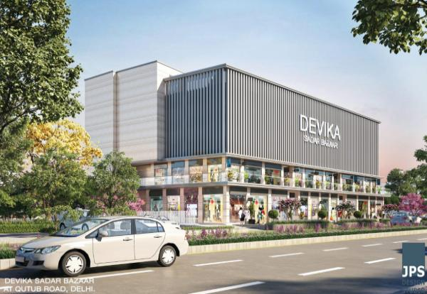
Phone: 08888672888
Website: https://www.devika-sadarbazar.com/

Slide 4
Contact Us
Phone: 08888672888
Devika Sadar Bazaar is a commercial build-out in Sadar Bazar
Phone No: 9999999237
Email ID: info@nofrillsdeal.com
Address: 9/52, Kirti Nagar Industrial Area, Delhi 110015, INDIA
Website: https://www.devika-sadarbazar.com/

